Slide 1



Hotel Booking Application
Presented By:- Milin Rao Deshmukh

Slide 2

Agenda
We begin with a brief introduction and the purpose behind analyzing hotel booking data. We then describe the dataset and tools used, followed by the key steps in data cleaning and feature engineering. The core of the analysis focuses on exploratory data analysis (EDA), uncovering trends in booking behavior, cancellations, and guest segmentation. We further analyze cancellation patterns, guest types, and market segments to identify meaningful insights. Based on these findings, we provide actionable recommendations aimed at reducing cancellations and improving revenue. The presentation concludes with a summary of key takeaways and suggestions for future improvements.

Slide 3
Problem Statement
The hotel industry faces constant challenges like high cancellations, fluctuating guest behaviour, and potential revenue loss.
To improve revenue and reduce losses, it’s important to understand:-
Why people cancel
How guest types affect bookings
What trends can guide better planning

Slide 4
Objective & Scope
Objective:
Use data analysis to uncover patterns in hotel bookings and recommend actions to reduce cancellations and optimize bookings.
Scope Includes:
Guest demographics and booking types
Cancellations and lead times
Seasonal, behavioral, and financial trends
Booking channels and country-wise behavior

Slide 5
Data Overview
Source: Hotel Booking Dataset
Size: 119,390 rows × 32 columns
Hotel Types: City Hotel & Resort Hotel
Duration: Data spans over 2+ years
Tools Used: Python (Pandas, NumPy, Matplotlib, Seaborn)

Slide 6
Data Cleaning & Feature Engineering
Handled missing values (e.g., children, country)
Removed duplicates (~900 rows)
Created new features: stay_length, total_guests, year_month
Converted data types for datetime fields
Segmented guests as domestic/international

Slide 7
Customer & Booking Profile
~60% bookings are from City Hotel
Majority are Transient guests
~25% of bookings have at least one special request
Domestic guests cancel more frequently than international guests

Slide 8
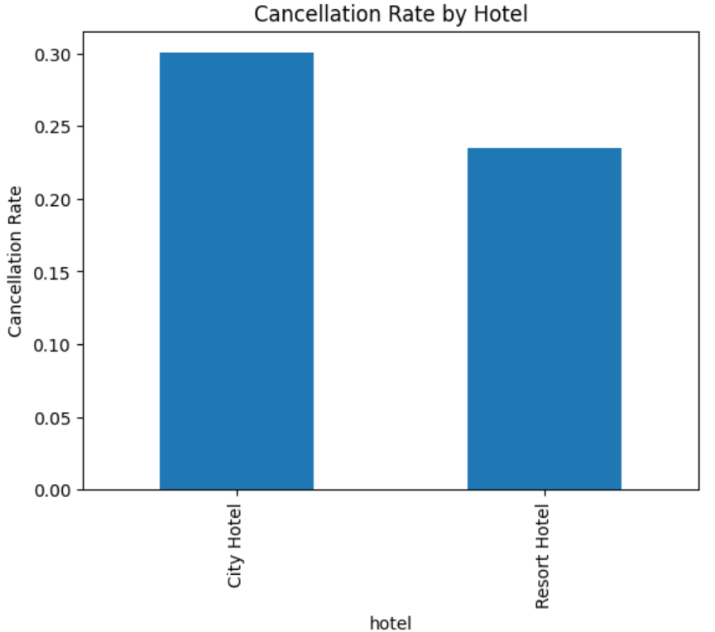
Hotel Type Analysis
Hotel Type | Cancellation Rate | ADR (Average Daily Rate)
City Hotel | Higher | Higher
Resort Hotel | Lower | Lower
Insight: City Hotels earn more per booking but face higher cancellation risk

Slide 9
Impact of Deposit Type
Deposit Type | Cancellation Rate
No Deposit | 26.7%
Refundable | 24.3%
Non-Refundable | 94.7%
Insight: Non-refundable bookings are not always secure may need stricter policies or verification.

Slide 10
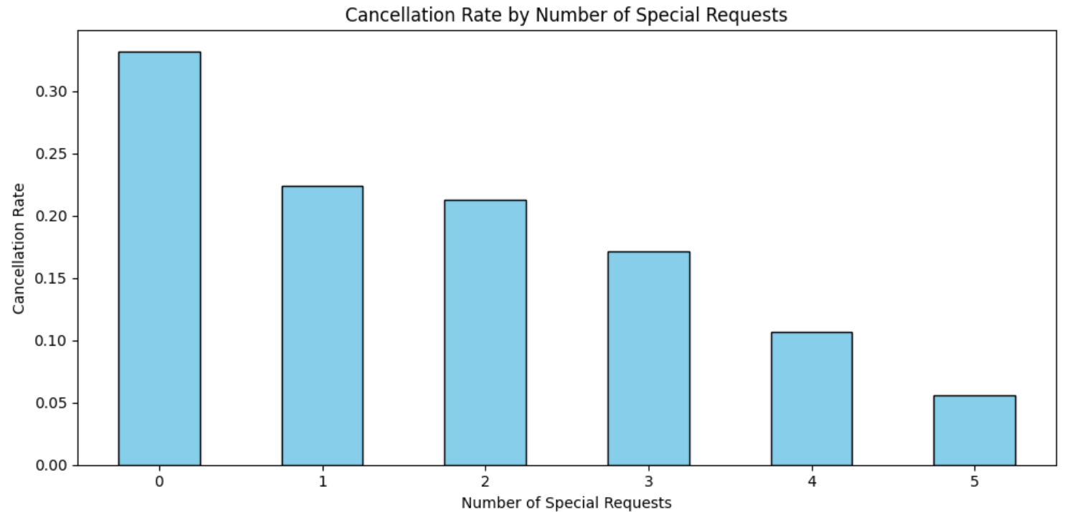
Special Requests & Cancellations
# Special Requests | Cancellation Rate
0 | 33%
3+ | <17%
Insight: More requests indicate stronger booking intent and lower risk of cancellation.

Slide 11
Guest Type Analysis
Guest Type | Cancellation Rate
First-Time | 28%
Repeat Guests | 7.6%
Insight: Repeat guests show strong loyalty and reliability.

Slide 12
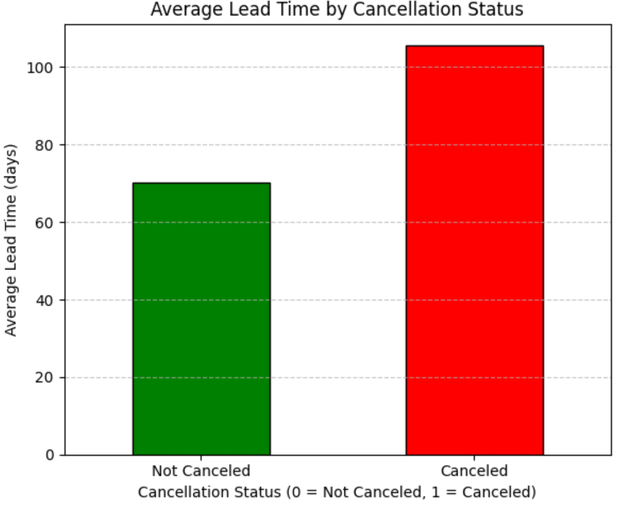
Lead Time Analysis
Lead Time (Days) | Cancellation Rate
~106 (Cancelled) | High
~70 (Not Cancelled) | Low
Insight: Longer planning horizon correlates with increased risk of cancellation.

Slide 13
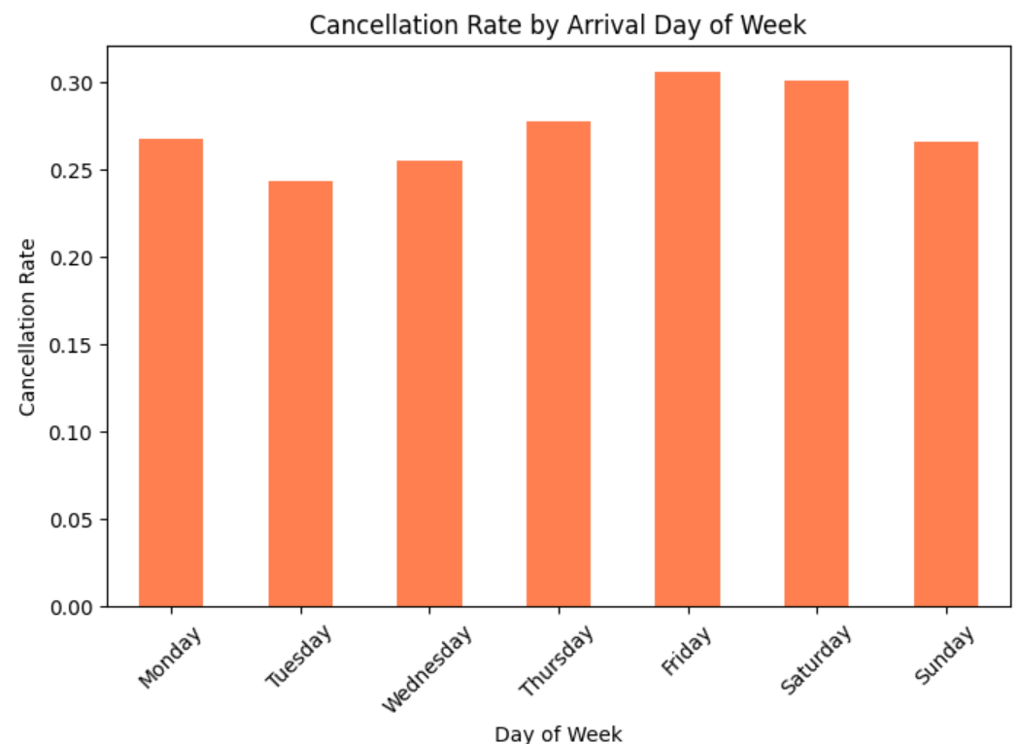
Day of Arrival Impact
Day | Cancellation Rate
Friday | 30.5%
Saturday | 30.1%
Tuesday | 24.3%
Insight: Weekend bookings are more likely leisure-oriented and hence more volatile.

Slide 14
Market Segment Analysis
Segment | Cancellation Rate
Online Travel Agents (OTA) | Highest
Corporate/Complementary | Lowest
Insight: OTA bookings are more prone to cancellations, requires stricter management or incentives for confirmations.

Slide 15
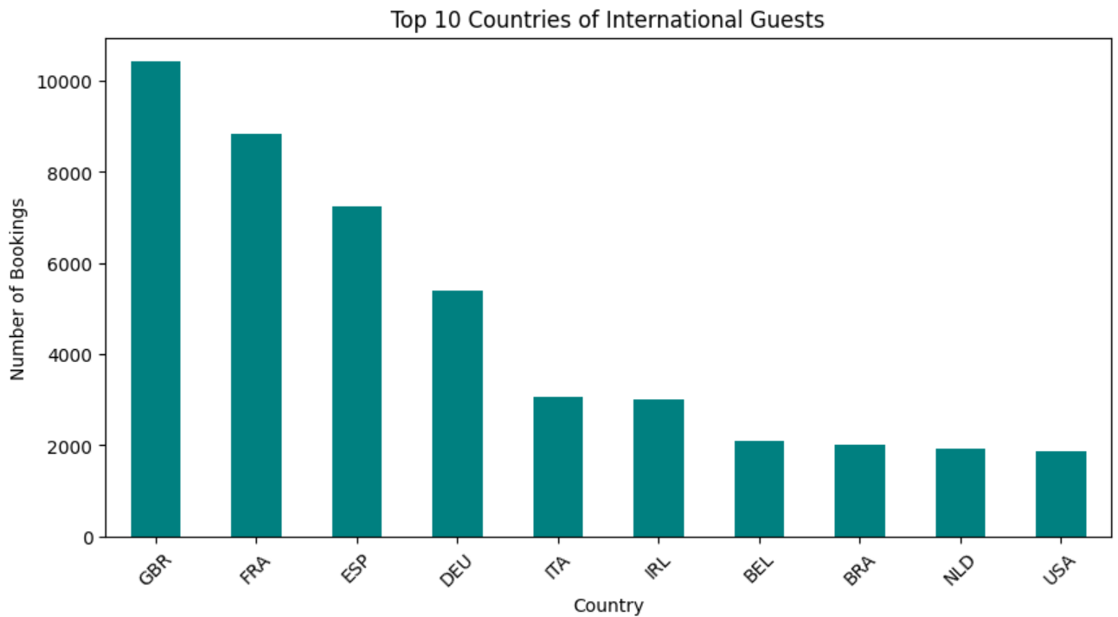
Country-wise Guest Behavior
Top 10 international guest countries include UK, France, Spain, Germany, USA.
International guests:-
Book earlier
Stay longer
Make more special requests
Cancel less frequently
Insight: International guests offer more stable and profitable bookings.

Slide 16
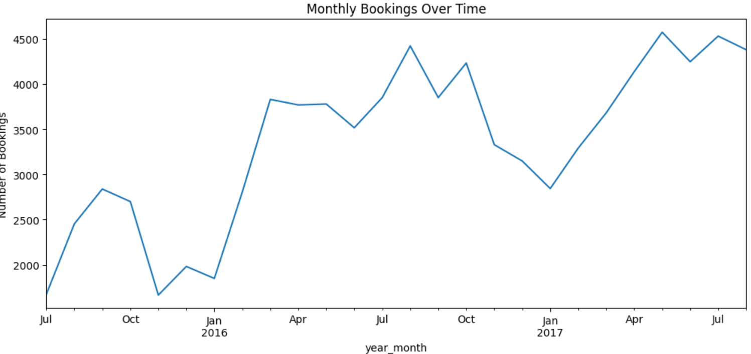
Monthly Booking Trends
Peak bookings in July and August
Dip in November and January
Summer months have high
cancellations
Insight: Seasonality impacts both volume and risk. Consider overbooking or flexible pricing.

Slide 17
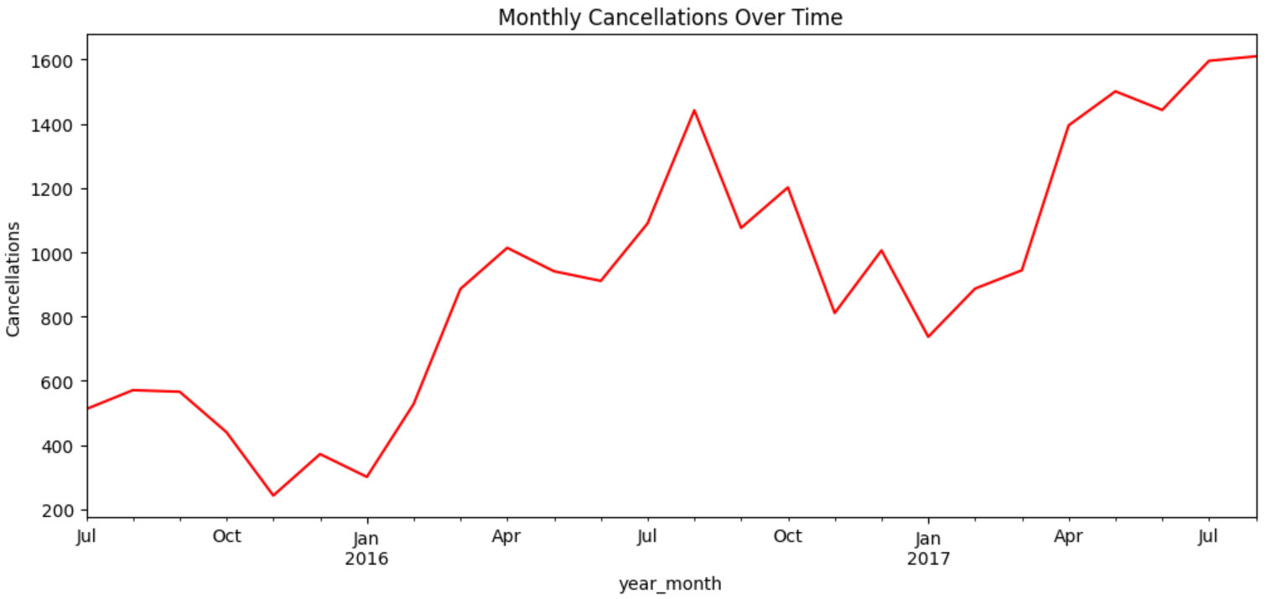
Monthly cancellations
Cancellations steadily increased from 2015 to 2017
The highest number of cancellations occurred in August 2017
The lowest were observed in November 2015 and January 2016
Insight:
Summer months, especially July and August, consistently experienced higher cancellations — possibly driven by overbooking during peak travel season or last-minute changes in guest plans.

Slide 18
Key Insights Summary
Longer lead time increases cancellation chances
Repeat guests and special requesters are more reliable
Weekend bookings show higher cancellation rates
OTA channel has the highest cancellation ratio
International guests are more valuable

Slide 19
Recommendations:
Reward repeat guests with loyalty benefits
Encourage special requests during booking for higher retention
Introduce stricter follow-ups for OTA bookings
Personalize offers for international travelers
Add incentives for early confirmation
Slightly overbook during high-risk periods

Slide 20
Conclusion
We have uncovered key patterns in guest behavior and booking cancellations. By identifying factors like guest type, lead time, and special requests, hotels can better predict cancellations and adjust strategies accordingly.
These insights give hotels the chance to take smarter actions — like targeting the right customer groups, adjusting booking policies, and improving the guest experience. Overall, this analysis helps turn raw booking data into clear strategies for reducing cancellations, increasing revenue, and making more confident business decisions.

Slide 21
Thank you

